Slide 1
Aim 1 Results

Slide 2
TOC
FV
Average stim

Slide 3
FV

Slide 4
1a: Single day effect story
Average stim has a nonzero effect on gait symmetry, while sham has no effect
However, STIM – SHAM is not different from zero
Final story: No difference in STIM vs. SHAM / STIM has no effect

Slide 5
1b: Stim parameters story
No difference between any stim parameters

Slide 6
1a: Single day effect
Dependent samples t-test of SHAM2 vs. average of the four interventions’ Cohen’s d

Slide 7
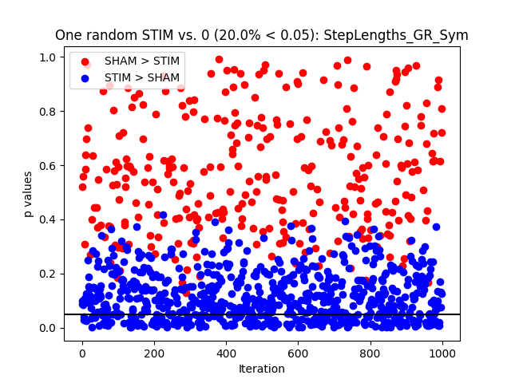
Step Lengths Sym
Sham vs. zero p=0.21
Average stim vs. sham p=0.82
Average stim vs. zero p=0.052
Best stim vs. sham p=0.0001
Best stim vs. zero p=0.0
Worst stim vs. sham p=0.0
Worst stim vs. zero p=0.0002
mean +/- std. dev Cohen’s d step lengths
Sham: 0.17 +/- 0.6
Average stim: 0.2 +/- 0.44
Average stim – sham: -0.02 +/- 0.55
Best stim: 0.91 +/- 0.57
Best stim – sham: -0.74 +/- 0.65
Worst stim: -0.53 +/- 0.53
Worst stim – sham: 0.71 +/- 0.60
Interpretation: No average stim effect
Best & worst stim has an effect
Notes:
"Y:\LabMembers\MTillman\GitRepos\Stroke-R01\results\stats\ttest_results\sham_vs_stim\symmetry\StepLengths_GR_Sym_ttest.pdf"

Slide 8
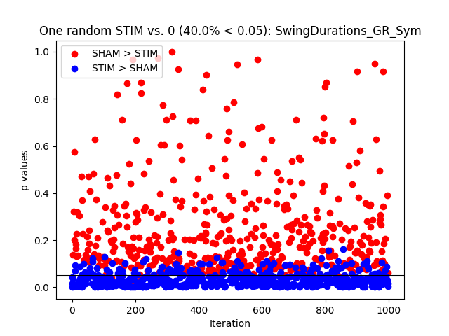
Swing Durations Sym
Sham vs. zero p=0.12
Average stim vs. sham p=0.90
Average stim vs. zero p=0.01
Best stim vs. sham p=0.0003
Best stim vs. zero p=0.0
Worst stim vs. sham p=0.0
Worst stim vs. zero p=0.0005
mean +/- std. dev Cohen’s d swing durations
Sham: 0.24 +/- 0.67
Average stim: 0.22 +/- 0.36
Average stim – sham: 0.02 +/- 0.62
Best stim: 0.84 +/- 0.42
Best stim – sham: -0.60 +/- 0.60
Worst stim: -0.41 +/- 0.44
Worst stim – sham: 0.66 +/- 0.55
Interpretation: No average stim effect
Best & worst stim has an effect
Notes:
"Y:\LabMembers\MTillman\GitRepos\Stroke-R01\results\stats\ttest_results\sham_vs_stim\symmetry\SwingDurations_GR_Sym_ttest.pdf"

Slide 9
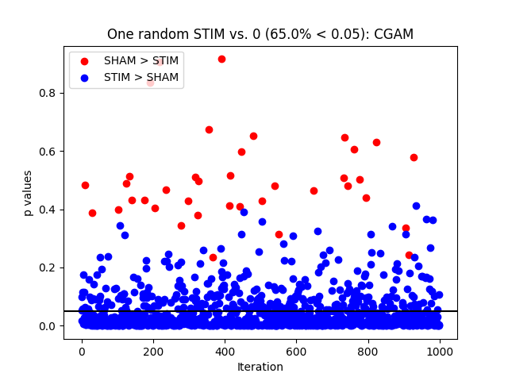
CGAM
Sham vs. zero p=0.30
Average stim vs. sham p=0.20
Average stim vs. zero p=0.0009
Best stim vs. sham p= 0.0001
Best stim vs. zero p=0.0
Worst stim vs. sham p=0.0009
Worst stim vs. zero p=0.0013
mean +/- std. dev Cohen’s d CGAM
Sham: 0.05 +/- 0.21
Average stim: 0.13 +/- 0.15
Average stim – sham: -0.08 +/- 0.26
Best stim: 0.35 +/- 0.21
Best stim – sham: -0.3 +/- 0.28
Worst stim: -0.14 +/- 0.17
Worst stim – sham: 0.19 +/- 0.22
Interpretation: Average stim effect? “Closer to neural drive”?
Best & worst stim has an effect
Notes:
"Y:\LabMembers\MTillman\GitRepos\Stroke-R01\results\stats\ttest_results\sham_vs_stim\symmetry\CGAM_ttest.pdf“
Figure from scientific notebook Aim 1

Slide 10
1b: Stim parameters
One way RM ANOVA of the four STIM interventions’ Cohen’s d

Slide 11
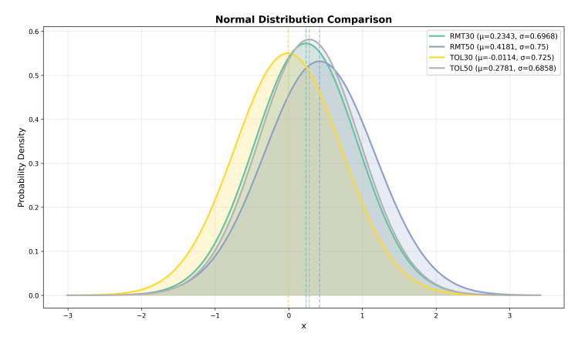
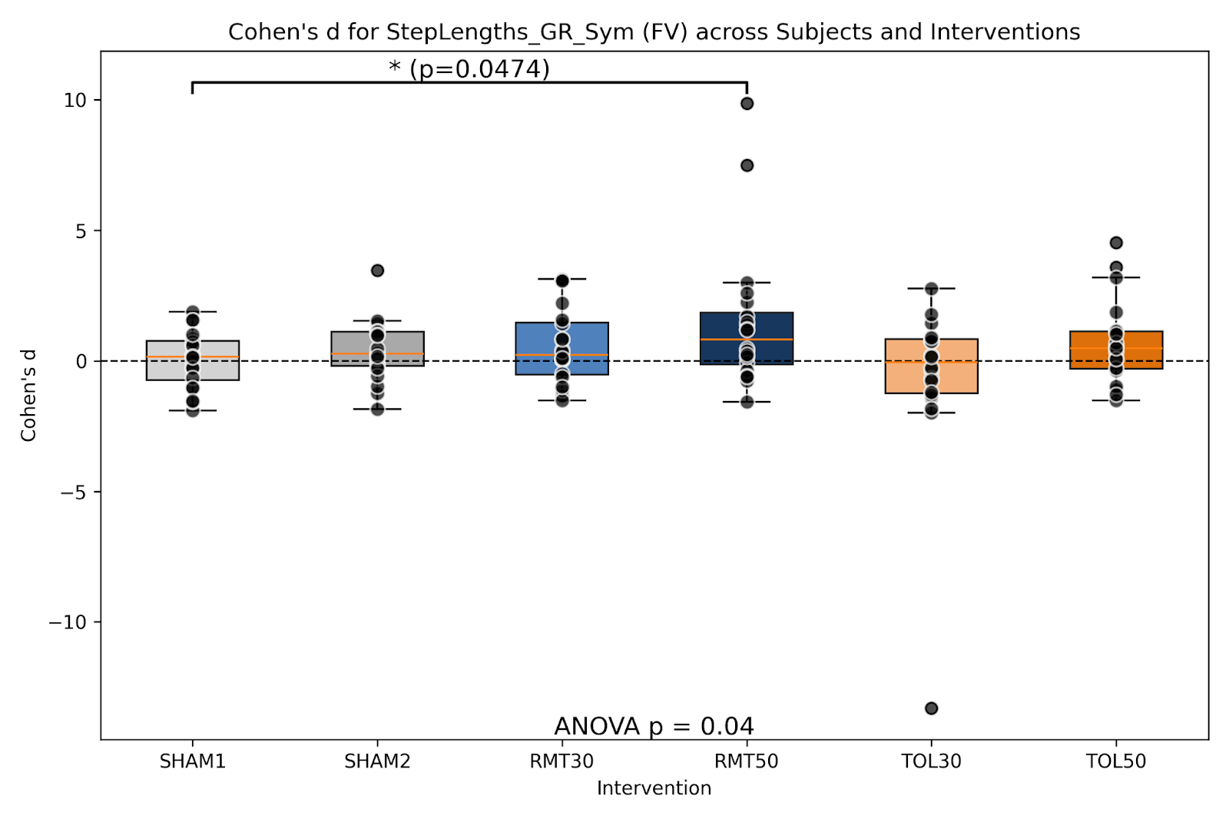
Step Lengths Sym
Omnibus p=0.20
Ignore p values on plot?
Notes:
"Y:\LabMembers\MTillman\GitRepos\Stroke-R01\results\stats\ANOVA results\between_interventions_cohensd_without_sham2\symmetry\StepLengths_GR_Sym_anova1way.pdf"

Slide 12
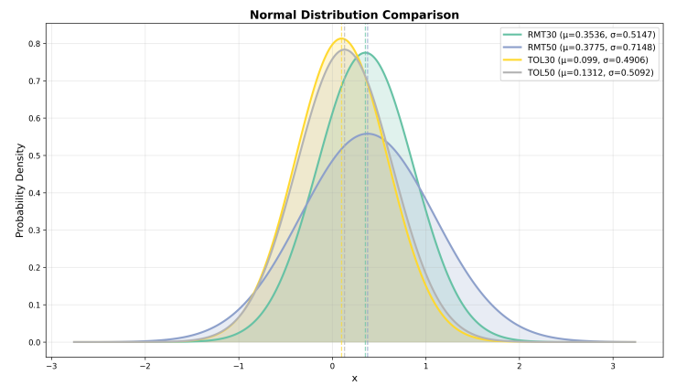
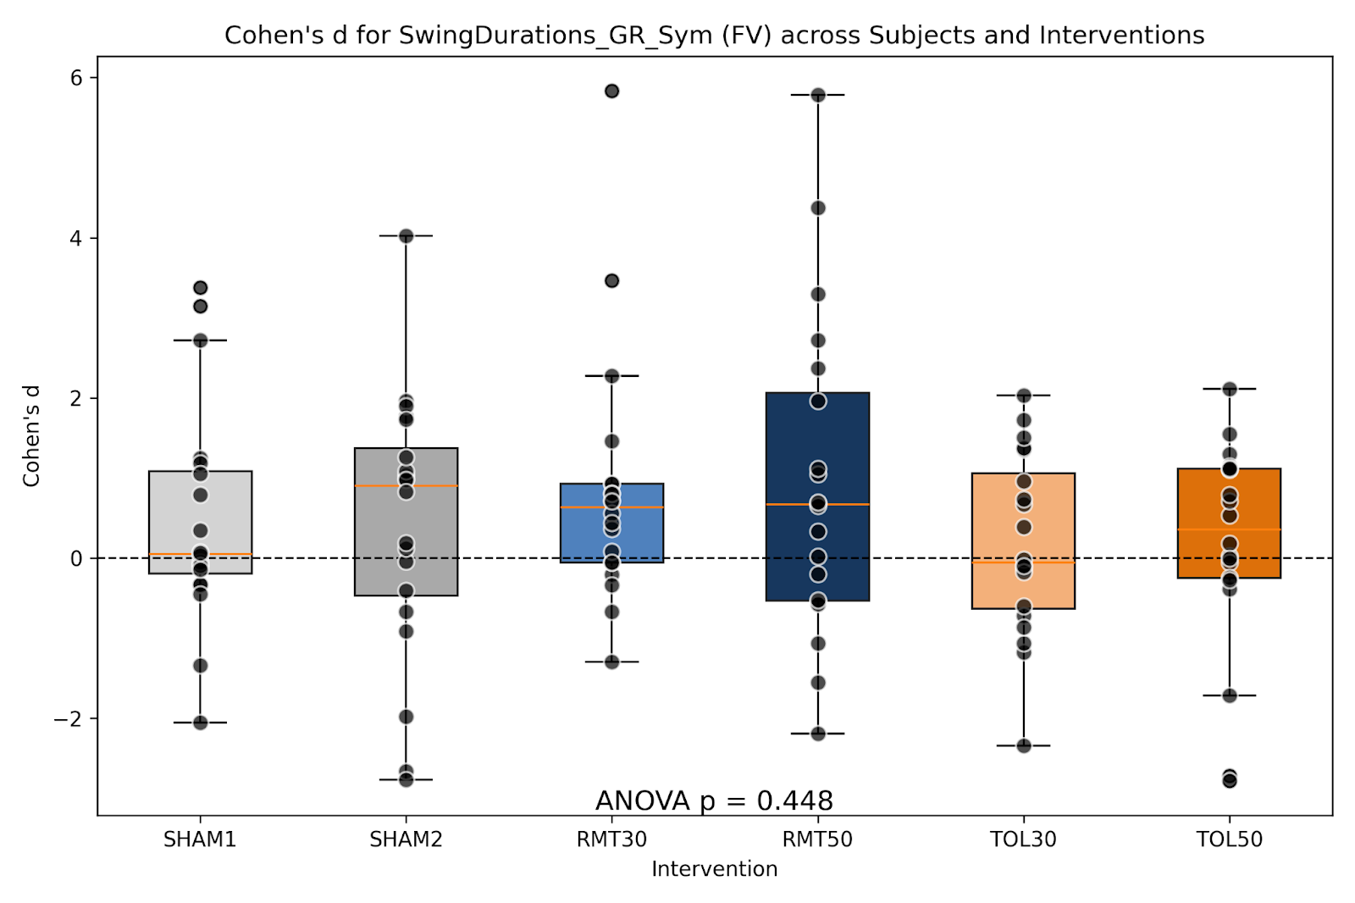
Swing Durations Sym
Omnibus p=0.19
Ignore p values on plot?
Notes:
"Y:\LabMembers\MTillman\GitRepos\Stroke-R01\results\stats\ANOVA results\between_interventions_cohensd_without_sham2\symmetry\SwingDurations_GR_Sym_anova1way.pdf“
Figure taken from scientific notebook Aim 1

Slide 13
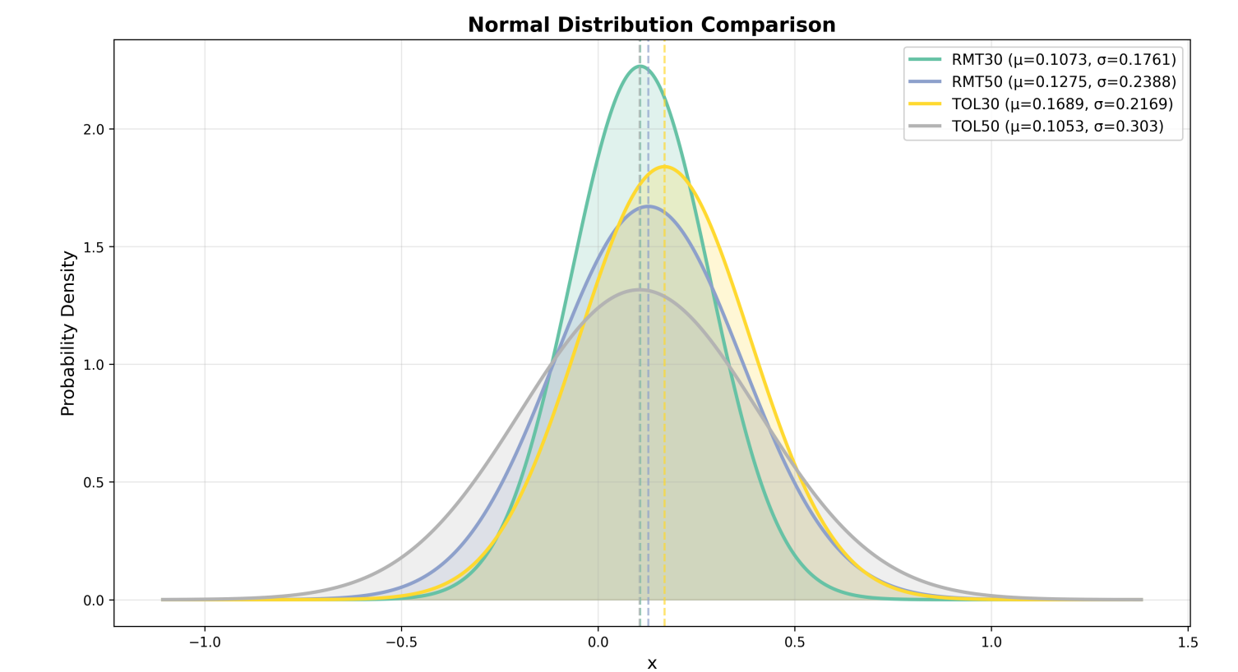
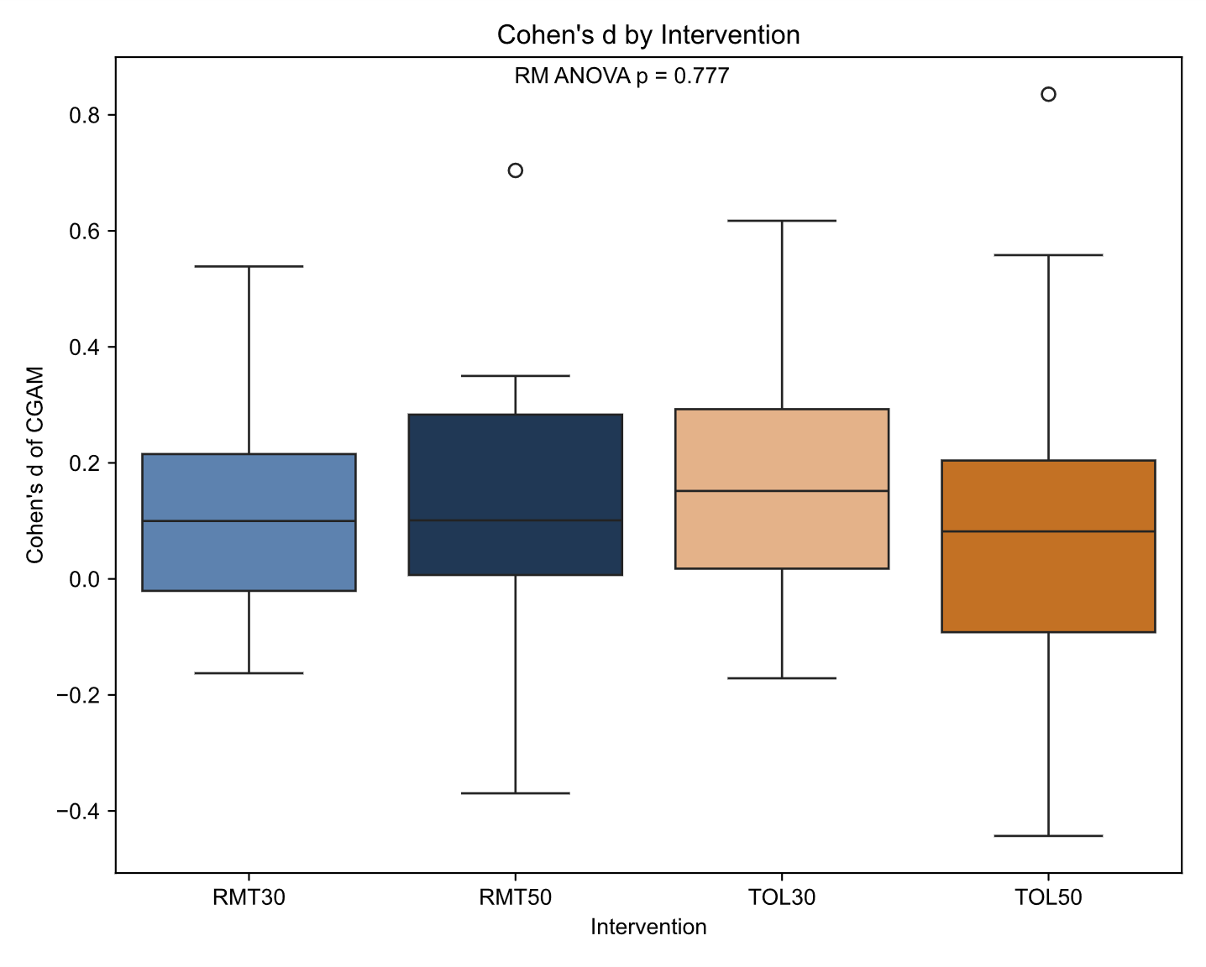
CGAM
Omnibus p=0.78
FV/SSV together?
Notes:
"Y:\LabMembers\J_Hunt\SS_Stroke\Per_Feature\Aim1_Paper\CGAM\figure2_CohenD_by_Intervention_CGAM.svg“
Figure taken from "Y:\LabMembers\J_Hunt\SS_Stroke\Per_Feature\Aim1_Paper\CGAM\figure2_CohenD_by_Intervention_CGAM.svg"

Slide 14
SSV

Slide 15
1a: Single day effect story

Slide 16
1b: Stim parameters story
No difference between any stim parameters

Slide 17
1a: Single day effect
Dependent samples t-test of SHAM2 vs. average of the four interventions’ Cohen’s d

Slide 18
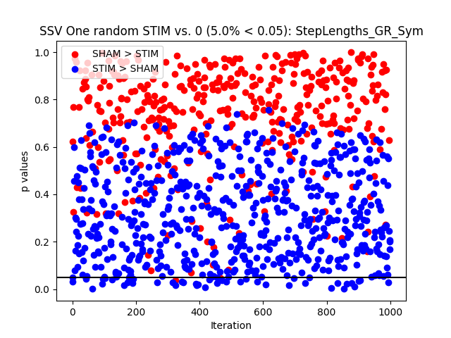
Step Lengths Sym
Sham vs. zero p=0.12
Average stim vs. sham p=0.96
Average stim vs. zero p=0.49
Best stim vs. sham p= 0.0
Best stim vs. zero p=0.0
Worst stim vs. sham p=0.0
Worst stim vs. zero p=0.0
mean +/- std. dev Cohen’s d step lengths
Sham: 0.07 +/- 0.5
Average stim: 0.06 +/- 0.4
Average stim – sham: 0.006 +/- 0.55
Best stim: 0.86 +/- 0.6
Best stim – sham: -0.8 +/- 0.64
Worst stim: -0.75 +/- 0.47
Worst stim – sham: 0.82 +/- 0.59
Interpretation: No average stim effect
But worst or best stim is different than sham & zero
Notes:
"Y:\LabMembers\MTillman\GitRepos\Stroke-R01\results\stats\ttest_results\sham_vs_stim\symmetry\StepLengths_GR_Sym_ttest.pdf"

Slide 19
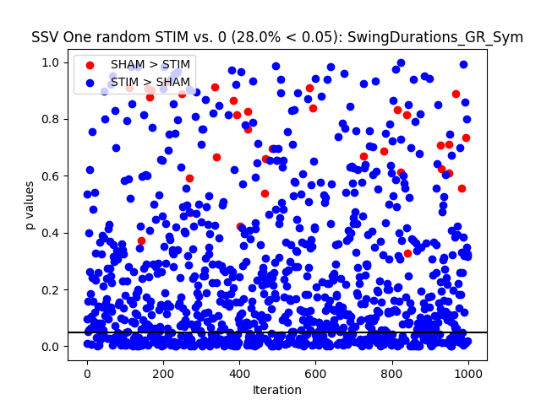
Swing Durations Sym
Sham vs. zero p=0.89
Average stim vs. sham p=0.10
Average stim vs. zero p=0.016
Best stim vs. sham p=0.0
Best stim vs. zero p=0.0
Worst stim vs. sham p=0.0001
Worst stim vs. zero p=0.0001
mean +/- std. dev Cohen’s d swing durations
Sham: -0.02 +/- 0.5
Average stim: 0.17 +/- 0.29
Average stim – sham: -0.19 +/- 0.48
Best stim: 0.75 +/- 0.3
Best stim – sham: -0.77 +/- 0.55
Worst stim: -0.51 +/- 0.47
Worst stim – sham: 0.49 +/- 0.46
Interpretation: No average stim effect vs. sham
Best & worst stim has effect.
Notes:
"Y:\LabMembers\MTillman\GitRepos\Stroke-R01\results\stats\ttest_results\sham_vs_stim\symmetry\SwingDurations_GR_Sym_ttest.pdf"

Slide 20
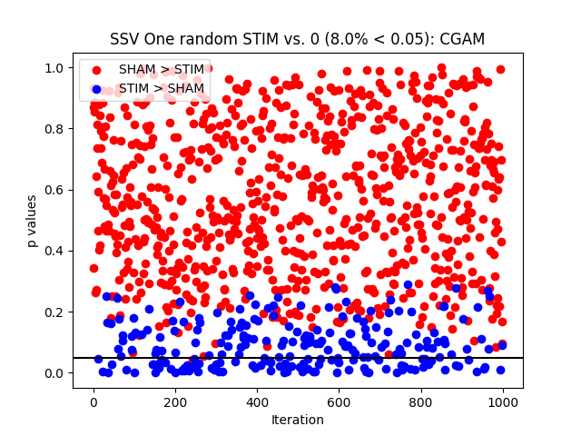
CGAM
Sham vs. zero p=0.32
Average stim vs. sham p=0.56
Average stim vs. zero p=0.25
Best stim vs. sham p=0.0001
Best stim vs. zero p=0.0
Worst stim vs. sham p=0.0003
Worst stim vs. zero p=0.0002
mean +/- std. dev Cohen’s d CGAM
Sham: 0.07 +/- 0.3
Average stim: 0.03 +/- 0.11
Average stim – sham: 0.04 +/- 0.28
Best stim: 0.29 +/- 0.14
Best stim – sham: -0.23 +/- 0.21
Worst stim: -0.27 +/- 0.26
Worst stim – sham: 0.33 +/- 0.33
Interpretation: No average stim effect
Best & worst has an effect
Notes:
"Y:\LabMembers\MTillman\GitRepos\Stroke-R01\results\stats\ttest_results\sham_vs_stim\symmetry\CGAM_ttest.pdf“
Figure from scientific notebook Aim 1

Slide 21
1b: Stim parameters
One way RM ANOVA of the four STIM interventions’ Cohen’s d

Slide 22
Step Lengths Sym
Omnibus p=0.57
Notes:
"Y:\LabMembers\MTillman\GitRepos\Stroke-R01\results\stats\ANOVA results\between_interventions_cohensd_without_sham2\symmetry\StepLengths_GR_Sym_anova1way.pdf"

Slide 23
Swing Durations Sym
Omnibus p=0.19
Notes:
"Y:\LabMembers\MTillman\GitRepos\Stroke-R01\results\stats\ANOVA results\between_interventions_cohensd_without_sham2\symmetry\SwingDurations_GR_Sym_anova1way.pdf“
Figure taken from scientific notebook Aim 1

Slide 24
CGAM
Omnibus p=
Notes:
"Y:\LabMembers\J_Hunt\SS_Stroke\Per_Feature\Aim1_Paper\CGAM\figure2_CohenD_by_Intervention_CGAM.svg“
Figure taken from "Y:\LabMembers\J_Hunt\SS_Stroke\Per_Feature\Aim1_Paper\CGAM\figure2_CohenD_by_Intervention_CGAM.svg"

